Slide 1


Food Storage Tips

Slide 2
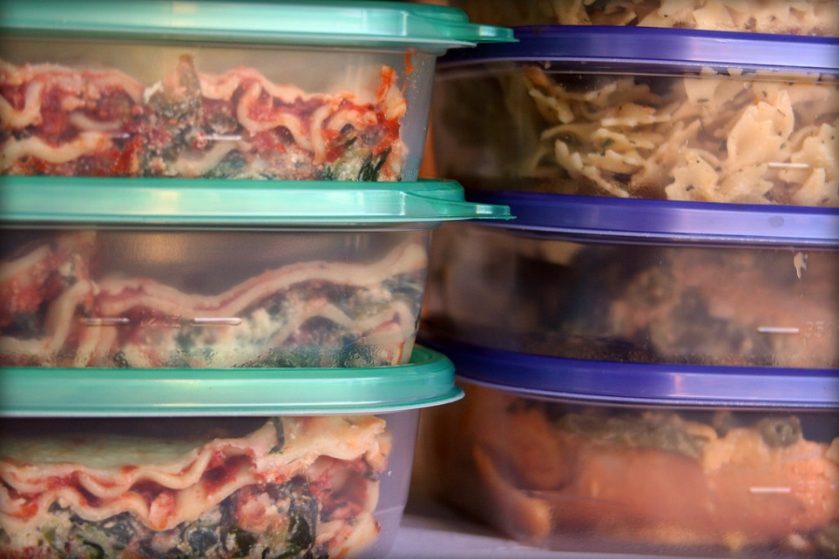
Store Leftovers in Clear Containers
It is easy to forget about leftovers in the fridge if we cannot see them. Clear containers help to remind us what we have.

Slide 3
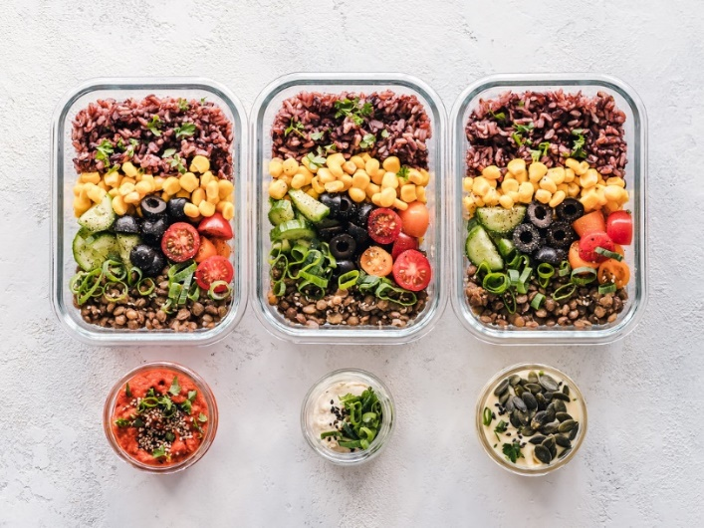
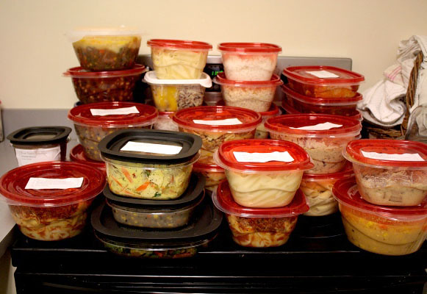

Label Your Prepared Food
Label your leftovers with the date it was prepared and remember to consume before it goes bad.
Veggie Quinoa Salad
Prepared on 5/20/20

Slide 4
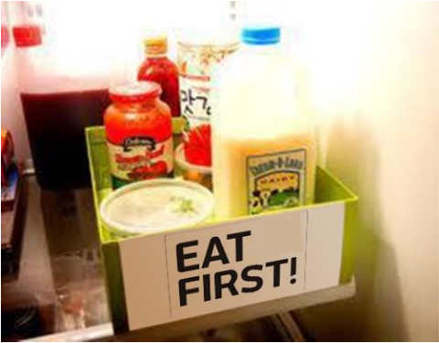
First In, First Out
Consume your oldest foods first. Create a section of your fridge for food that will spoil soon or label an “Eat Me First”Bin.

Slide 5
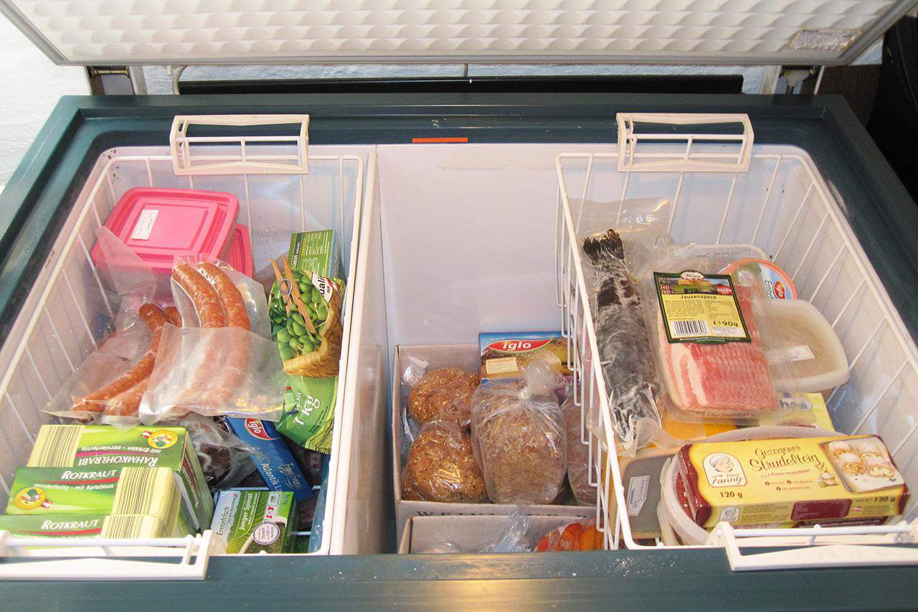
Freeze Your Food
Freeze what you can’t eat now. Almost anything can be frozen and saved!

Slide 6
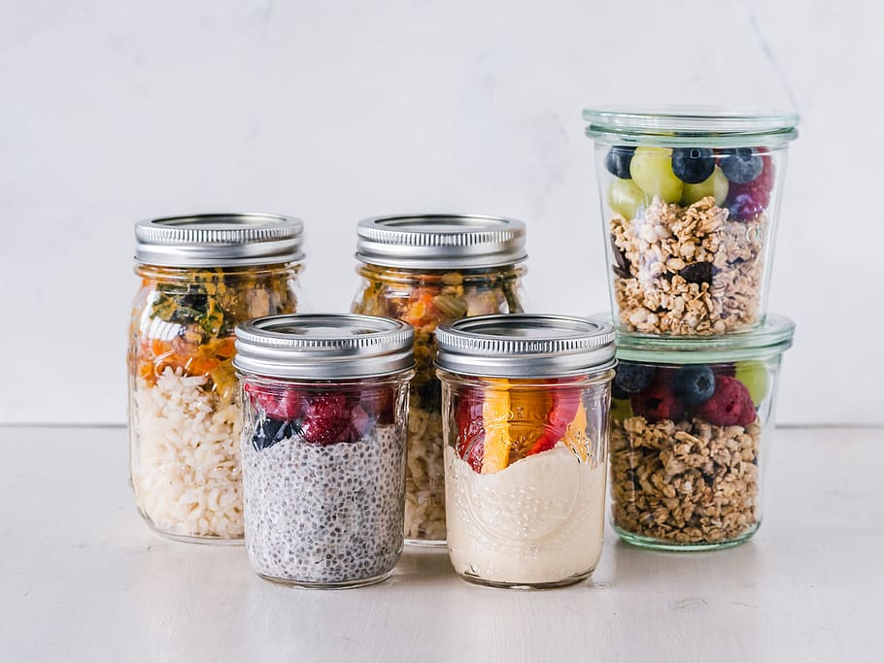
Use Airtight Containers
Storing perishables in airtight containers locks out oxygen and preserves the food for longer. Mason jars are great!

Slide 7
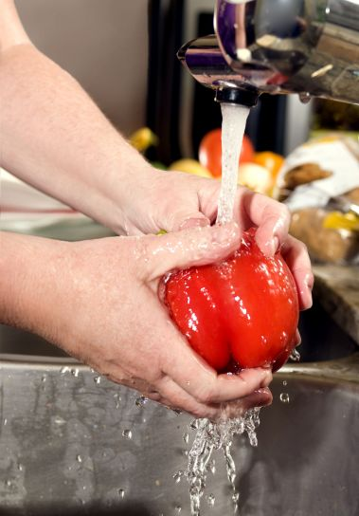
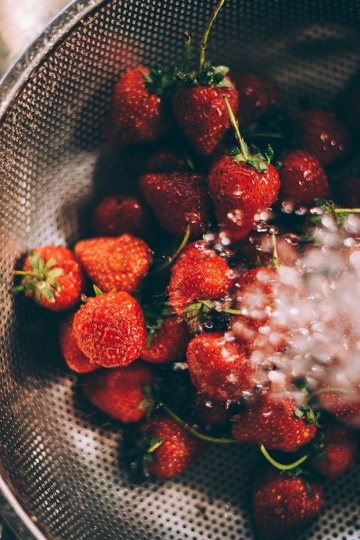
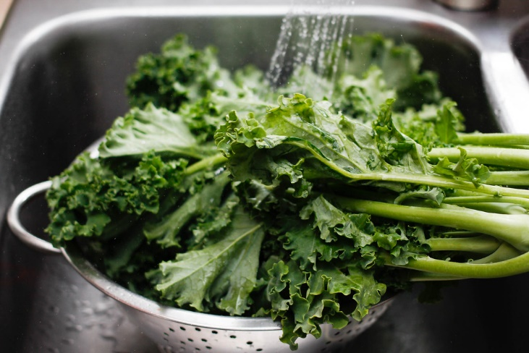
Wash Produce as You Go
Moist spots can quickly soften fruit and vegetable skin and attract bacteria.

Slide 8
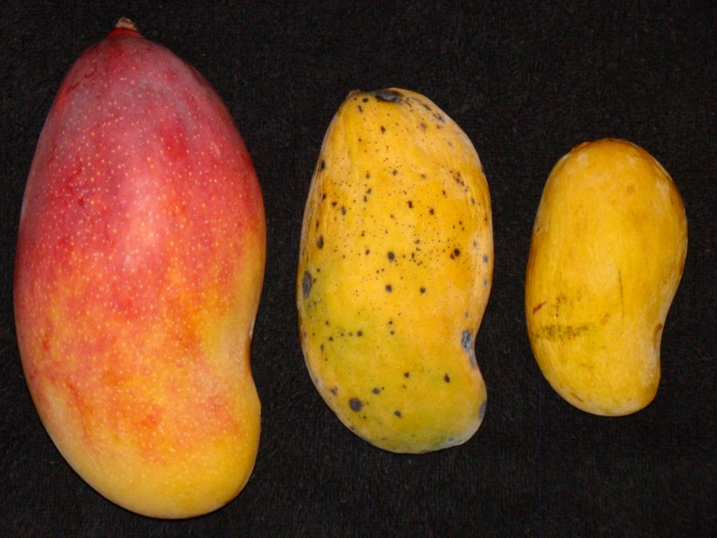
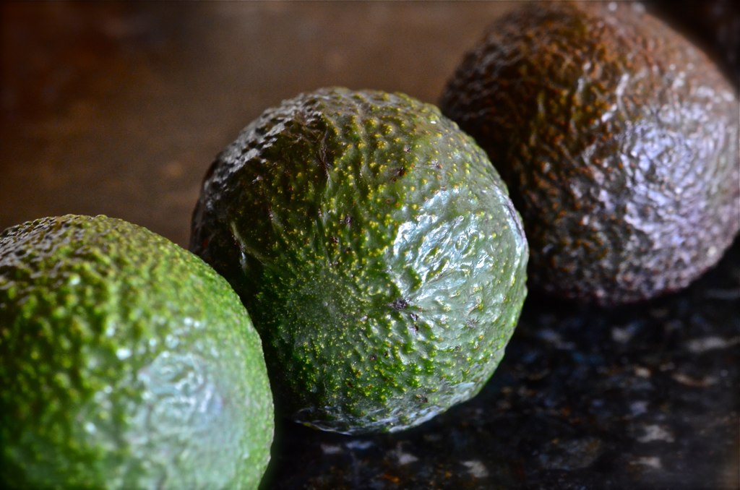
Refrigerate Ripening Produce
Placing ripening produce in the fridge slows down the ripening process.

Slide 9

Ready to test your knowledge?

